Slide 1
PROGRAMMING
LANGUAGES
Markelov Sergei, 1PIb-02-3op-22

Slide 2
01
CLASSIFICATION OF PROGRAMMING LANGUAGES

Slide 3

WHAT IS A PROGRAMMING LANGUAGE?
A programming language is a set of instructions that allows humans to communicate with computers. It lets us create software, websites, games, and more.

Slide 4

CLASSIFICATION
Programming languages can be grouped based on several factors:
Low-Level Languages: Closer to machine code, like Assembly, used for hardware control.
High-Level Languages: Easier for people to read, like Python or Java, used for application development.

Slide 5

CLASSIFICATION
Programming languages also follow different paradigms, or styles:
Procedural: Focuses on a sequence of instructions, like C.
Object-Oriented: Organizes code into "objects," like Java.
Functional: Emphasizes mathematical functions, like Haskell.

Slide 6
02
C++

Slide 7
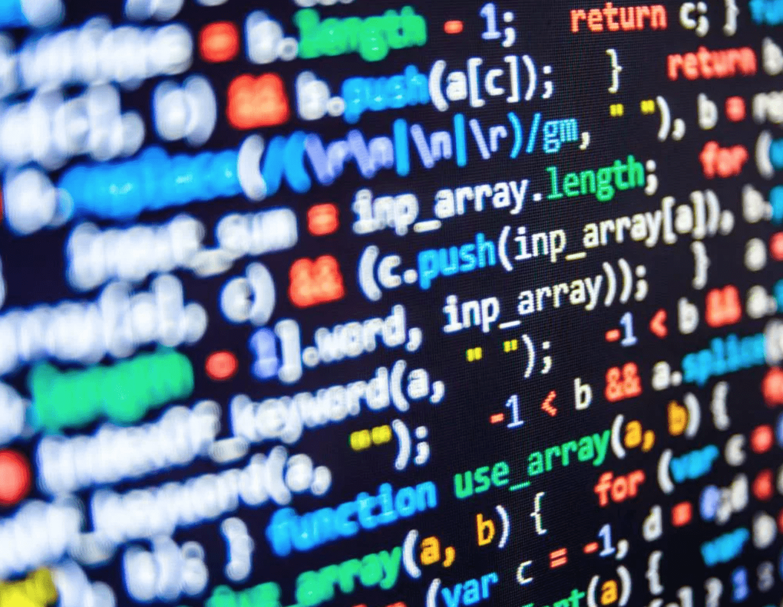
ABOUT C++
C++ is a powerful, versatile, and widely-used programming language. It combines the performance of low-level programming with the flexibility of high-level languages, making it suitable for a variety of applications.

Slide 8

KEY FEATURES
Object-Oriented: Supports concepts like classes and inheritance.
High Performance: Close to hardware for speed and efficiency.
Multi-Paradigm: Combines procedural, object-oriented, and functional styles.
Portability: Runs on multiple platforms and architectures.

Slide 9

C++ IN PRACTICE
C++ is commonly used for:
Game Development: Frameworks like Unreal Engine.
Operating Systems: Core parts of Windows and Linux.
Embedded Systems: Programming hardware devices.
Financial Systems: High-frequency trading platforms.

